Slide 1
CS2523 - Computer Organisation and Assembly Language
First Assembly Program
AFD Debugger

Slide 2
Lets revise the last lecture

Slide 3
Basic Computer Organization
iAPX 88 Registers (16-bit)
Notes:
Intel advance processor extension. The improved version is iAPX386 which has a length of 32 accumulator.
Intel’s first 8 bit processor was intel 8080 with 64k of main memory very simple architecture. When the processor became obsolete for the new demanding application the intel introduced the iAPX88 processor with 1Mb of main memory the IBM used it in its machine i.e. PC-XT.

Slide 4
iAPX 88 Registers (16-bit)
General Purpose
AX
BX
CX
DX
Notes:
X means that it is extended register.

Slide 5
iAPX 88 Registers (16-bit)
General Purpose
16-bit
AX
AH
AL
8-bit
8-bit
Notes:
AL – A register with low side
AH – A register with high side
Similarly BL and BH are also 16 bit register on the next slide. Also these 16 bit registers are general purpose and we can use anyone as either 16bit or two 8bits registers i.e. AL,AH
A is for the accumulator register,
B is for the Base register and is also used in memory.
C is for the counter register. The programs has instructions which are automatically incremented and the incremented counter is placed in counter register.
D is for the Destination register.

Slide 6
iAPX 88 Registers (16-bit)
General Purpose
16-bit
BX
BH
BL
8-bit
8-bit

Slide 7
iAPX 88 Registers (16-bit)
General Purpose
AX A→ Accumulator Register
BX B→ Base Register
CX C→ Counter Register
DX D→ Destination Register
Notes:
D stands for destination in i/o operations.

Slide 8
iAPX 88 Registers (16-bit)
Pointer / Index / Base
SI
DI
Notes:
These are a new class of registers which we call Index registers and are used in referring to strings instructions these registers can not be divided into 8bit like General registers.
These are used to store memory address.
SI = Source index register
DI = Destination index register

Slide 9
iAPX 88 Registers (16-bit)
Pointer / Index / Base
SI SI→ Source Index
DI DI→ Destination Index
IP IP→ Instruction Pointer
SP SP→ Stack Pointer
BP BP→ Base Pointer
Notes:
Instruction pointer: This is the register that the processor uses for its self and there is no user manipulation that can be done with this register.
Stack Pointer: Memory pointer usually the programmer can not manipulate it but there are some instructions that use this register
Base Pointer: Pointer register used to access a particular location in the memory

Slide 10
iAPX 88 Registers (16-bit)
Flag Register
-
-
-
-
O
D
I
T
S
Z
-
A
-
P
-
C
C = Carry S = Sign Bit
P = Parity T = Trap Flag
A= Auxiliary Carry I = Interrupt Flag
Z= Zero Bit D = Direction Flag
O = Overflow
Notes:
Parity: is used mostly in communication where we see the number of one’s and determine weather they are odd and even.
Auxiliary Carry: When we update add or subtract on nibble by nibble basis rather than byte by byte basis than we it can happen that there is a nibble cary from one nibble to another and this changes the value of hexadecimal this is called the auxiliary carry.
Zero Bit: The Z bit is set if the last mathematical or logical instruction has produced a 0 in its destination. For example we use this bit in many time to see our counters as weather it has been decremented to 0 or not because according to this value we will make some decision.
Sign bit : The last bit or the MSB bit is the sign bit of some data register i.e the value added in the destination is either negative or positive.
Trap Flag: Error
Interrupt Flag: Signal from an external environment can be blocked or unblocked for I/O devices by the processor so as to not interrupt the important work.
Direction Flag: if 0 than we copy the number from small to the high value and if it is 1 than we copy number from higher to small value.
Over Flow: Related with signed arithmetic which means that the last value of the bit is used for the sign information rather than included in numerical value

Slide 11
Registers
Program Counter
Instruction Pointer
Function:
Address of next instruction to be executed

Slide 12
Instruction Groups
Data Movement Instructions
Arithmetic / Logic Instructions
Program Control Instructions
Special Instructions

Slide 13
Data Movement
mov ax,bx ; move data from bx to ax
lda 0234 ; load 0234 into ; accumulator

Slide 14
Arithmetic and Logic Instructions
and ax,1234 ; AND 1234 with ax
add bx,0534 ; ADD 0534 to bx
add bx,[1200] ; ADD data at address 1200 to bx
add ax,[1234] ; ADD data from address 1234 to ax

Slide 15
iAPX 88 Registers (16-bit)
Segment
CS CS→ Code Segment
DS DS→ Data Segment
SS SS→ Stack Segment
ES ES→ Extra Segment

Slide 16
iAPX 88 Registers (16-bit)
General Purpose
AX AH,AL
BX BH,BL
CX CH,CL
DX DH,DL

Slide 17
General Instruction Format
instruction dest, src
instruction dest
instruction src
Notes:
some instructions have only one source or destination. And in some cases one is either source or destination and other operand is employed.

Slide 18
In this lecture we will learn…
Write
Assemble
Debug
execute

Slide 19
Assembler
NASM
The Netwide Assembler

Slide 20
Linker
ALINK
Notes:
Linking object to make it executable as object code is its self not executable so the linker is used to convert it into an executable.

Slide 21
Debugger
AFD
Advanced Full Screen Debug

Slide 22
EX01.ASM
[ORG 0X100]
mov ax,5
mov bx,10
Add ax,bx
Mov bx,15
Add ax,bx
Mov ax,0x4c00
Int 0x21
Notes:
ORG 0X100 means that originate at 100 location and when we make a command file than it is necessary that its should start at 100 and this can also be seen in the debugger. The debugger show the starting address of the program from 100 which means that it is starting from 100 hex memory location.
Int 0x21; int 21h means, call the interrupt handler 0x21 which is the DOS Function dispatcher.
This simply means that you are using function 01h of the Interrupt type 21. Where 01h is to read character from standard input. if there is no character in the keyboard buffer, the function waits until any key is pressed.

Slide 23
Explanation
ORG 0X100 means that originate at 100 location and when we make a command file than it is necessary that its should start at 100 and this can also be seen in the debugger. The debugger show the starting address of the program from 100 which means that it is starting from 100 hex memory location.
To start writing the program from 100 address in RAM.
So AX, 4C00h can also be written as
mov ah, 4Ch
mov al, 00h
Really you are just suppose to do mov ah, 4Ch. What most likely the person was doing is zeroing out, or "resetting" whats in AL, because AL may be some "random" number set beforehand by another function, so that may cause the program to pass 4C and lets say 46, so 4C46 and then call int 21h. Whats 4C46? No clue, and the computer will think the same and cause an error. So just resetting to zero to avoid an error.
Notes:
ORG 0X100 means that originate at 100 location and when we make a command file than it is necessary that its should start at 100 and this can also be seen in the debugger. The debugger show the starting address of the program from 100 which means that it is starting from 100 hex memory location.
So AX, 4C00h can also be written as
mov ah, 4Ch
mov al, 00h
Really you are just suppose to do mov ah, 4Ch. What most likely the person was doing is zeroing out, or "resetting" whats in AL, because AL may be some "random" number set beforehand by another function, so that may cause the program to pass 4C and lets say 46, so 4C46 and then call int 21h. Whats 4C46? No clue, and the computer will think the same and cause an error. So just resetting to zero to avoid an error.
Int 0x21; int 21h means, call the interrupt handler 0x21 which is the DOS Function dispatcher.
This simply means that you are using function 01h of the Interrupt type 21. Where 01h is to read character from standard input. if there is no character in the keyboard buffer, the function waits until any key is pressed.

Slide 24
Explanation
Int 0x21; int 21h means, call the interrupt handler 0x21 which is the DOS Function dispatcher.
To tell computer that our program has been terminated.
To tell CPU to deallocate the memory which was allocated to this program
Which resources was given to this program, take them back
After that nothing will execute, only you can declare variables.
Notes:
ORG 0X100 means that originate at 100 location and when we make a command file than it is necessary that its should start at 100 and this can also be seen in the debugger. The debugger show the starting address of the program from 100 which means that it is starting from 100 hex memory location.
So AX, 4C00h can also be written as
mov ah, 4Ch
mov al, 00h
Really you are just suppose to do mov ah, 4Ch. What most likely the person was doing is zeroing out, or "resetting" whats in AL, because AL may be some "random" number set beforehand by another function, so that may cause the program to pass 4C and lets say 46, so 4C46 and then call int 21h. Whats 4C46? No clue, and the computer will think the same and cause an error. So just resetting to zero to avoid an error.
Int 0x21; int 21h means, call the interrupt handler 0x21 which is the DOS Function dispatcher.
This simply means that you are using function 01h of the Interrupt type 21. Where 01h is to read character from standard input. if there is no character in the keyboard buffer, the function waits until any key is pressed.

Slide 25
Assembler
Assembler would create .com file.
Convert your code into machine code.
Language of machine is 0 or 1.

Slide 26
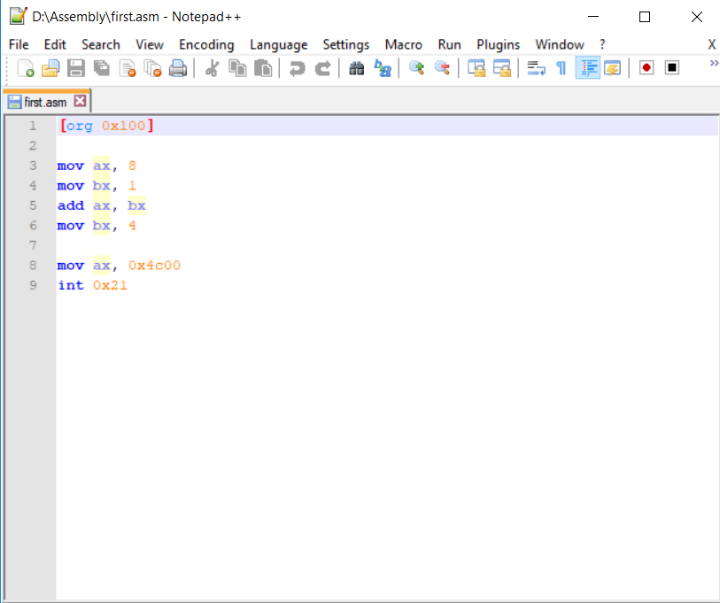
First.ASM

Slide 27
Commands to execute the code
cls – to clear screen of DOSBox
mount m: path of directory where assembly code is placed. e.g. mount m: d:\assembly
m:
dir – to display files of directory m
Assemble –
nasm first.asm –o fir.com
Execute
fir.com [No output; since we have not displayed anything on screen]

Slide 28
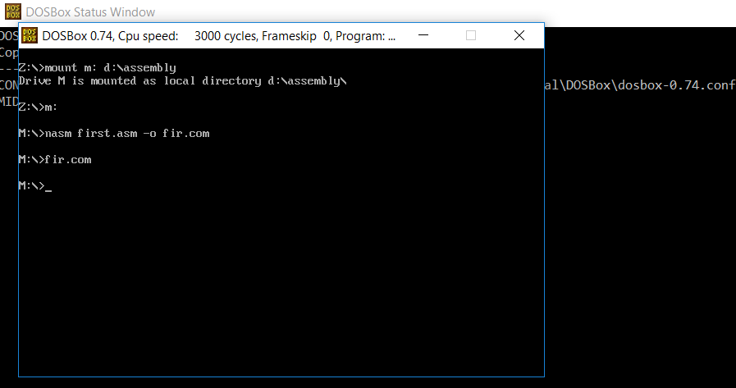
Commands to execute the code

Slide 29
Commands to execute the code
Listing File –
Create: nasm first.asm –l firstlist.lst
View: type firstlist.lst

Slide 30
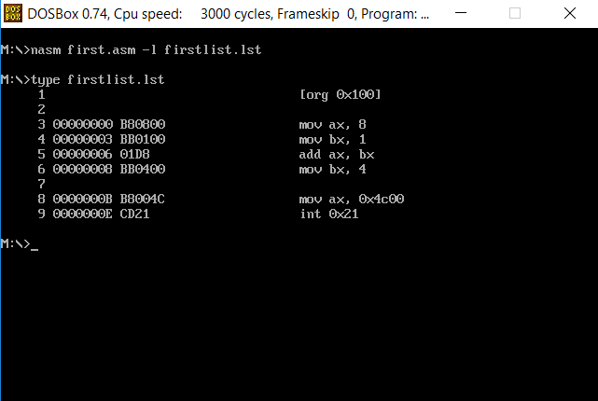
Commands to execute the code
Difference of 3 bytes in instruction
Difference of 2 bytes in instruction

Slide 31
Commands to debug the code
Debugger – If we want to see the value of registers we use debugger. We’ll use AFD Debugger. AFD stands for Advanced Full Screen Debugger.
Command to open Debugger
afd fir.com
To execute the program’s instructions one by one
Tow keys are used to execute instructions step by step
F1 and F2

Slide 32
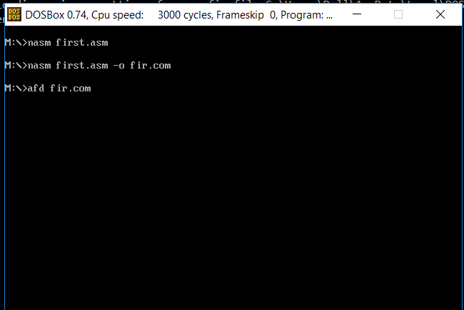
Commands to debug the code

Slide 33
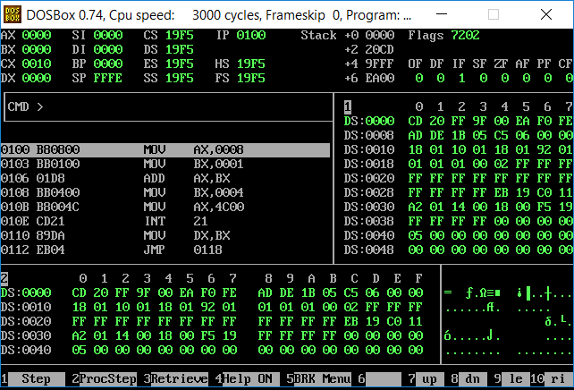
Commands to debug the code

Slide 34
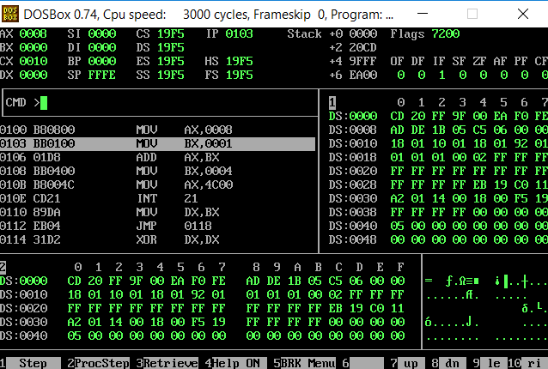
After pressing F1 one time – Value of AX is changed

Slide 35
Word Representation
When we have number of 16 bit or greater than we have to decide how to place the number in the memory which means that what will be the byte order.
Either
Intel uses little endian Notation which means that lesser significant byte at lesser address.
For the example of assembly code
The instruction add ax,bx the value shown by the ex01.lst is 01D8 this is a two byte instruction and 01 is the opcode off add and the DB shows two registers ie ax,bx
Generally we can not change the values of these two registers
Notes:
When we have number of 16 bit or greater than we have to decide how to place the number in the memory which means that what will be the byte order.
Either
Intel uses little endian Notation which means that lesser significant byte at lesser address.
For the example of assembly code
The instruction add ax,bx the value shown by the ex01.lst is 01D8 this is a two byte instruction and 01 is the opcode off add and the DB shows two registers ie ax,bx
Generally we can not change the values of these two registers

Slide 36
Word Representation
4 Byte Word
Representation in Memory
MSB
LSB
Representation 1
Little Endian Notation
MSB
LSB
0 1 2 3
Representation 2
Big Endian Notation
LSB
MSB
0 1 2 3
Notes:
When we have number of 16 bit or greater than we have to decide how to place the number in the memory which means that what will be the byte order.
Either
Intel uses little endian Notation which means that lesser significant byte at lesser address.
For the example of assembly code
The instruction add ax,bx the value shown by the ex01.lst is 01D8 this is a two byte instruction and 01 is the opcode off add and the DB shows two registers ie ax,bx
Generally we can not change the values of these two registers

Slide 37
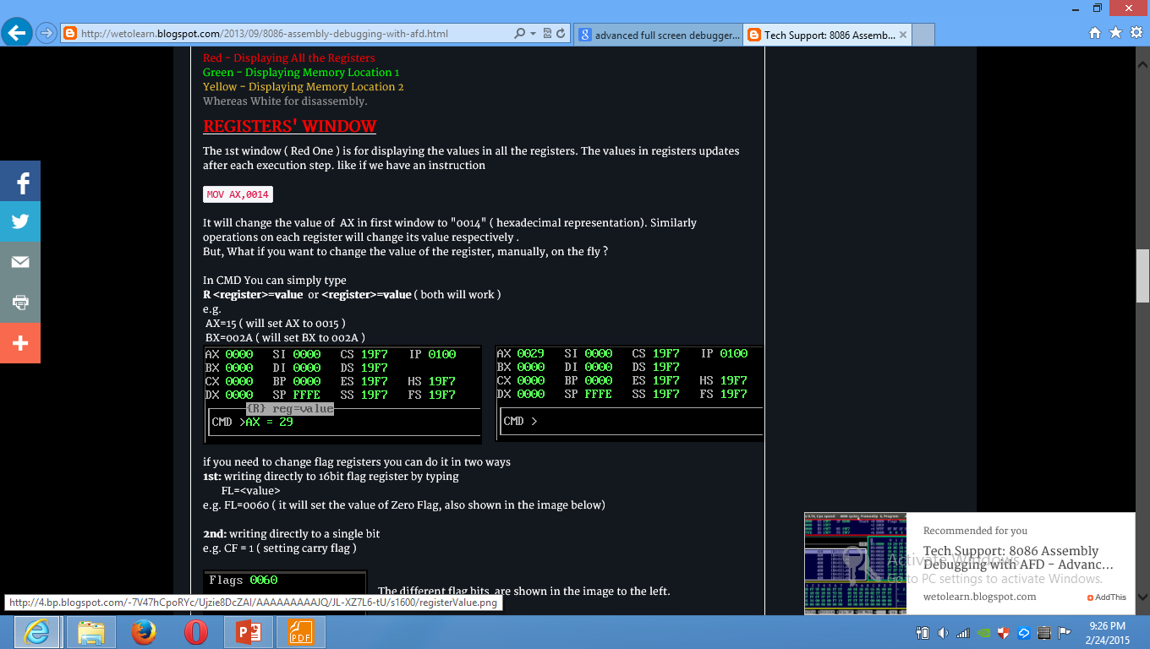

Slide 38
